Slide 1
The “Change Bibliographic Reference” link for POLs
Yoel Kortick
Senior Librarian
Alma Product Management

Slide 2
“Change Bibliographic Reference” link for POLs
The “Change Bibliographic Reference” link for POLs is used to relink the POL description to either a new or updated bibliographic record.
The “Change Bibliographic Reference” link differs from the “Relink POL” link because
  The “Relink POL” link changes the actual record to which the POL is linked
  The “Change Bibliographic Reference” link changes only the description of the POL but remains linked to the same record. This change will not impact the inventory and will only update the PO Line's description

Slide 3
“Change Bibliographic Reference” link for POLs
A typical use case would be:
  The order is made on a “short bibliographic record” (sometimes referred to as a “stub” record)
  The POL description therefore gets the description of the “short bibliographic record”
  The “short bibliographic record” then gets updated with a full (or otherwise modified) version
  The POL description remains with the “old version” of the title
  The staff user can then choose “Change Bibliographic Reference” and update the POL description according the new version of the record (or a different record if desired)

Slide 4
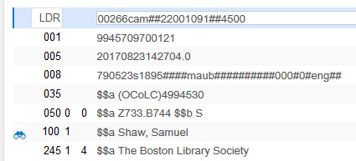
“Change Bibliographic Reference” link for POLs
For example here is the short bibliographic record of title ‘The Boston Library Society’ OCLC number 4994530 and an order is created:
Limited bibliographic information short bibliographic record

Slide 5
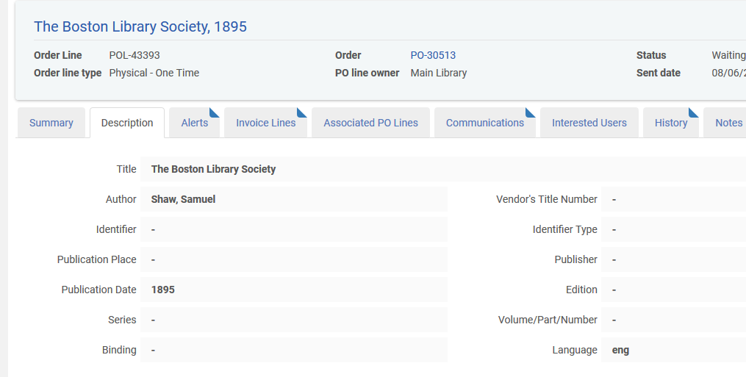
“Change Bibliographic Reference” link for POLs
The POL description comes from the short bibliographic record

Slide 6
“Change Bibliographic Reference” link for POLs
The bibliographic record to which the POL is linked is MMS ID 9945709700121

Slide 7
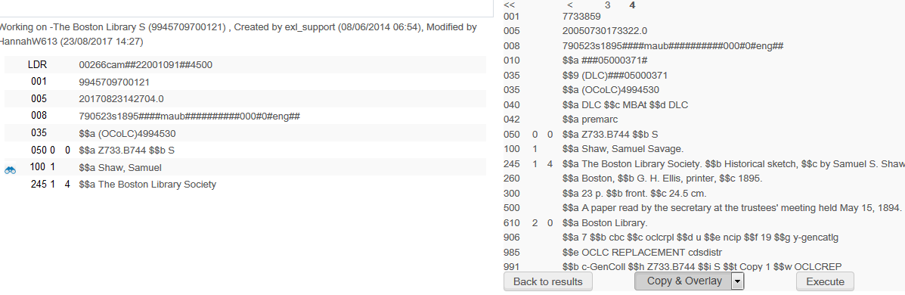
“Change Bibliographic Reference” link for POLs
The bibliographic record to which the POL is linked is updated (overlaid) with a full version

Slide 8
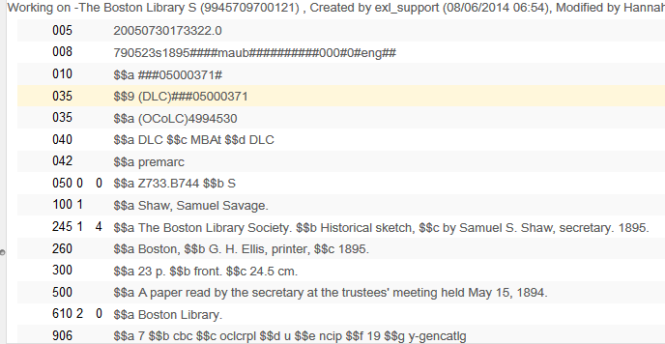
“Change Bibliographic Reference” link for POLs
Now MMSID 9945709700121 is the full version (longer title and more fields, for example)

Slide 9
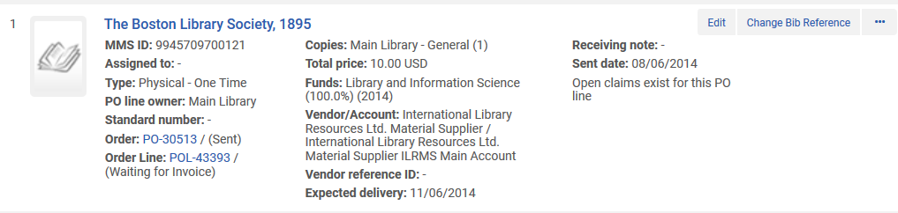
“Change Bibliographic Reference” link for POLs
But the POL did not get updated
If we want it to get updated we will click “Change Bib Reference”
POL still has old title as description
We will click “Change Bib Reference”

Slide 10
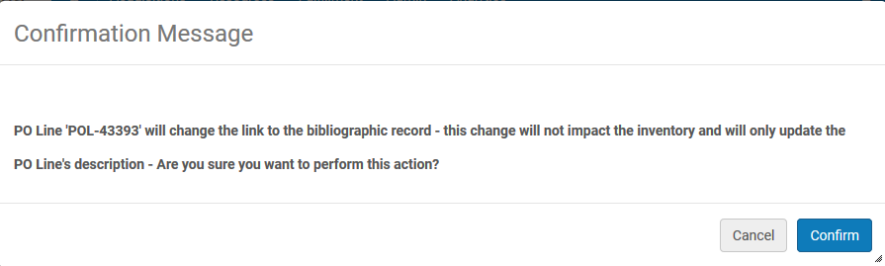
“Change Bibliographic Reference” link for POLs
Get this message and click “Confirm”

Slide 11
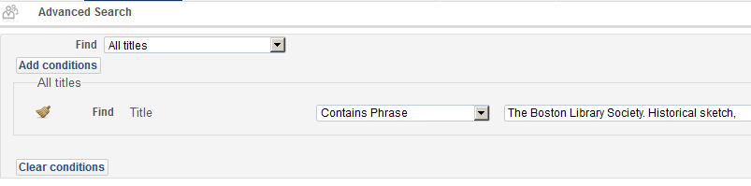
“Change Bibliographic Reference” link for POLs
Search for the current or a different record (we will search for the current record, which is the default)
This automatically gets filled in with full title bibliographic record to which the POL is linked

Slide 12
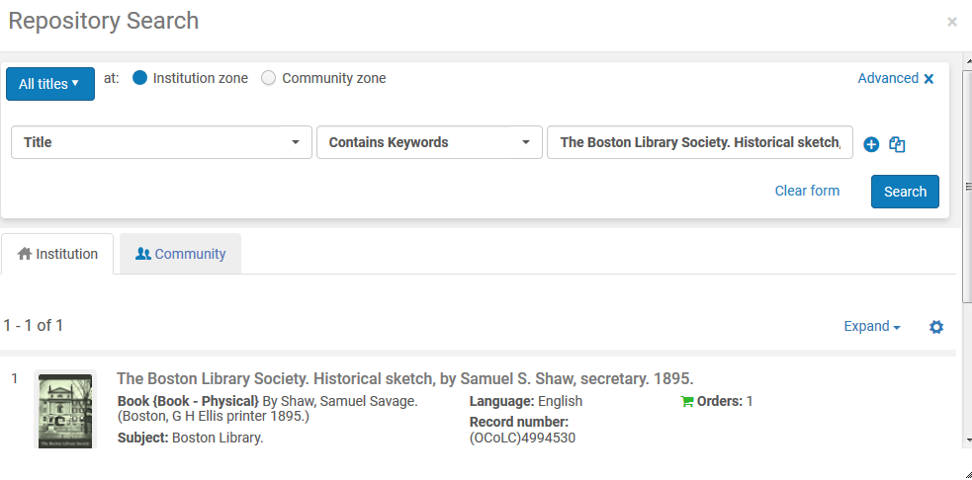
“Change Bibliographic Reference” link for POLs
Select the bibliographic record

Slide 13
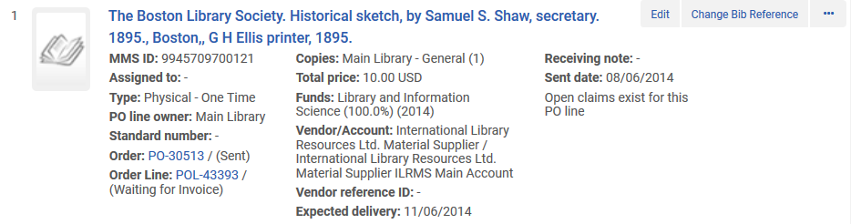
“Change Bibliographic Reference” link for POLs
Now the POL description has changed to be from the updated version of the bibliographic record
After
Before

Slide 14
“Change Bibliographic Reference” link for POLs
Now the POL description has changed, but the actual record to which the POL is linked has not changed.
The POL is linked to the same record, but the description changed according to the current version of the same bibliographic record
The POL is still linked to the same MMS ID 9945709700121, but now has the full bibliographic information.

Slide 15
Thank You

